Slide 1
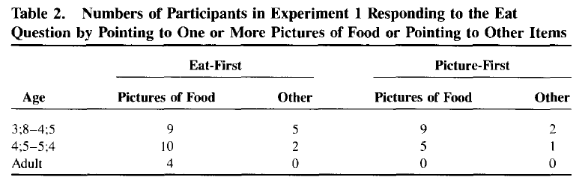
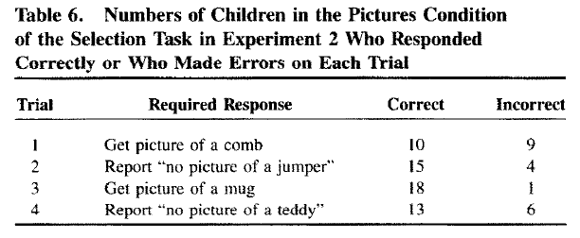
Thomas, G.V., Nye, R. & Robinson, E.J. (1993). How children view pictures: Children’s responses to pictures as things in themselves and as representations of something else.
Theory
Pictures can be understood both in terms of their referent subject (e.g., a cat) and also as representations in their own right (e.g., a picture of a cat).
Authors examined to what extent children around age 4 could treat pictures as “transparent” and attend to them as things in and of themselves (as opposed to as referents). Thus, does a child recognize that a picture of a cat is just a picture, not really a cat?
Methods
4 experiments involving children ages 3-4. All experiments examined when children were willing and able to treat pictures as things as as opposed to attending to them as referents of something else.
Exp’t 1: Children shown 2 foods and 2 pictures of food, and asked “Which can you eat?” and “Which are just pictures?”
Exp’t 2: Experimenter says “My feet are cold” and child has to bring real socks, not picture of socks.
Key insight
Strengths
Each experiment addressed a shortcoming of previous ones. Experiment 3 compared children’s responses to pictures and plastic objects. Experiment 4 compared responses to pictures of items with drawings of items.
Limitations
Methodology may confound linguistic skill with the ability to distinguish between pictures as referents and pictures as representations.
Conclusions overly negative given # of children who responded correctly, especially with increasing age.
Findings
Results suggest that children ages 3 to 4 have a strong tendency to inappropriately focus on the referent of a picture despite cues that they should focus on the picture as an object in and of itself. Children may lack the ability to conceptualize the dual identity of pictures.

